Slide 1
Hybrid Knowledge Retrieval for Medical Visual Question Answering
Team Members:
Marryam Yahya, Mariam Nabil, Nada Radwan, Yomna Nagib, Esraa Ismail
Supervisor/s:
Dr. Ensaf
Eng. Zeyad Elshaer

Slide 2
Agenda
Introduction
Problem Statement
Related Work
Research Gap and Main Contributions
Methodology
Large Language Models
Data Verification
Data Generation
Fine-Tuning
Discussion and Results
Data Evaluation
Performance analysis
Conclusion
Key Findings
Limitations
Future work

Slide 3
Introduction

Slide 4
Problem Statement
Medical VQA systems often act as “black boxes,” offering answers without explaining the reasoning behind them. This lack of transparency makes it hard for clinicians to trust and use these tools in real healthcare settings. While some datasets include images, questions, and answers, they rarely provide detailed diagnostic explanations. Creating such explanations manually is time-consuming and requires expert knowledge, and no effective automated solution exists. There is a clear need for VQA systems that are both accurate and interpretable to support safe clinical decision-making.

Slide 5



Related Work
Datasets and Benchmarks
Models and Architectures
Multi-modality & Explainability
MLeVLM improves radiology QA, InstructBLIP leverages instruction tuning, and Flamingo enables few-shot learning but lacks medical pretraining.
Contrastive Pre-training and PubMedCLIP enhance dual-modality alignment.
Huatuo-26M provides a vast text-based Chinese medical QA dataset, while PATHVQA focuses on medical visual question answering
Interpretability through multimodal rationales and LLM-generated explanations

Slide 6
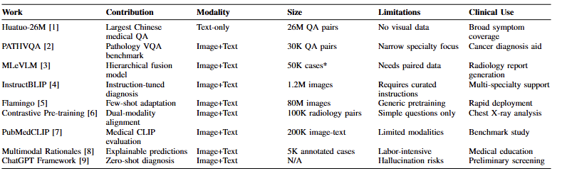

Slide 7
Research Gap
Current medical VQA systems remain limited in scalability, generalizability, and multi-modality alignment. While recent advances have improved alignment and explainability a bit, challenges persist in handling diverse medical workflows and reducing hallucination risks, especially for open-ended questions. Most datasets are either model-based, restricted or overly specialized. Future work should focus on document-enhanced VQA systems that integrate clinical context with multimodal data, coupled with better generalization.
This shift could bridge the gap between research benchmarks and real-world clinical decision support in VQA.

Slide 8

Contribution of the Work
Advanced multi-modal framework
Combines LLMs with Retrieval-Augmented Generation and Knowledge Graphs for more accurate medical reasoning.
State-of-the-art performance
Achieves the highest recorded score on the R-RAD benchmark, setting a new standard for medical VQA
Explainable answers:
Generates rationale-backed responses using Agentic RAG system, making generated answers more reasonable, especially for open-ended questions.

Slide 9
Methodology

Slide 10
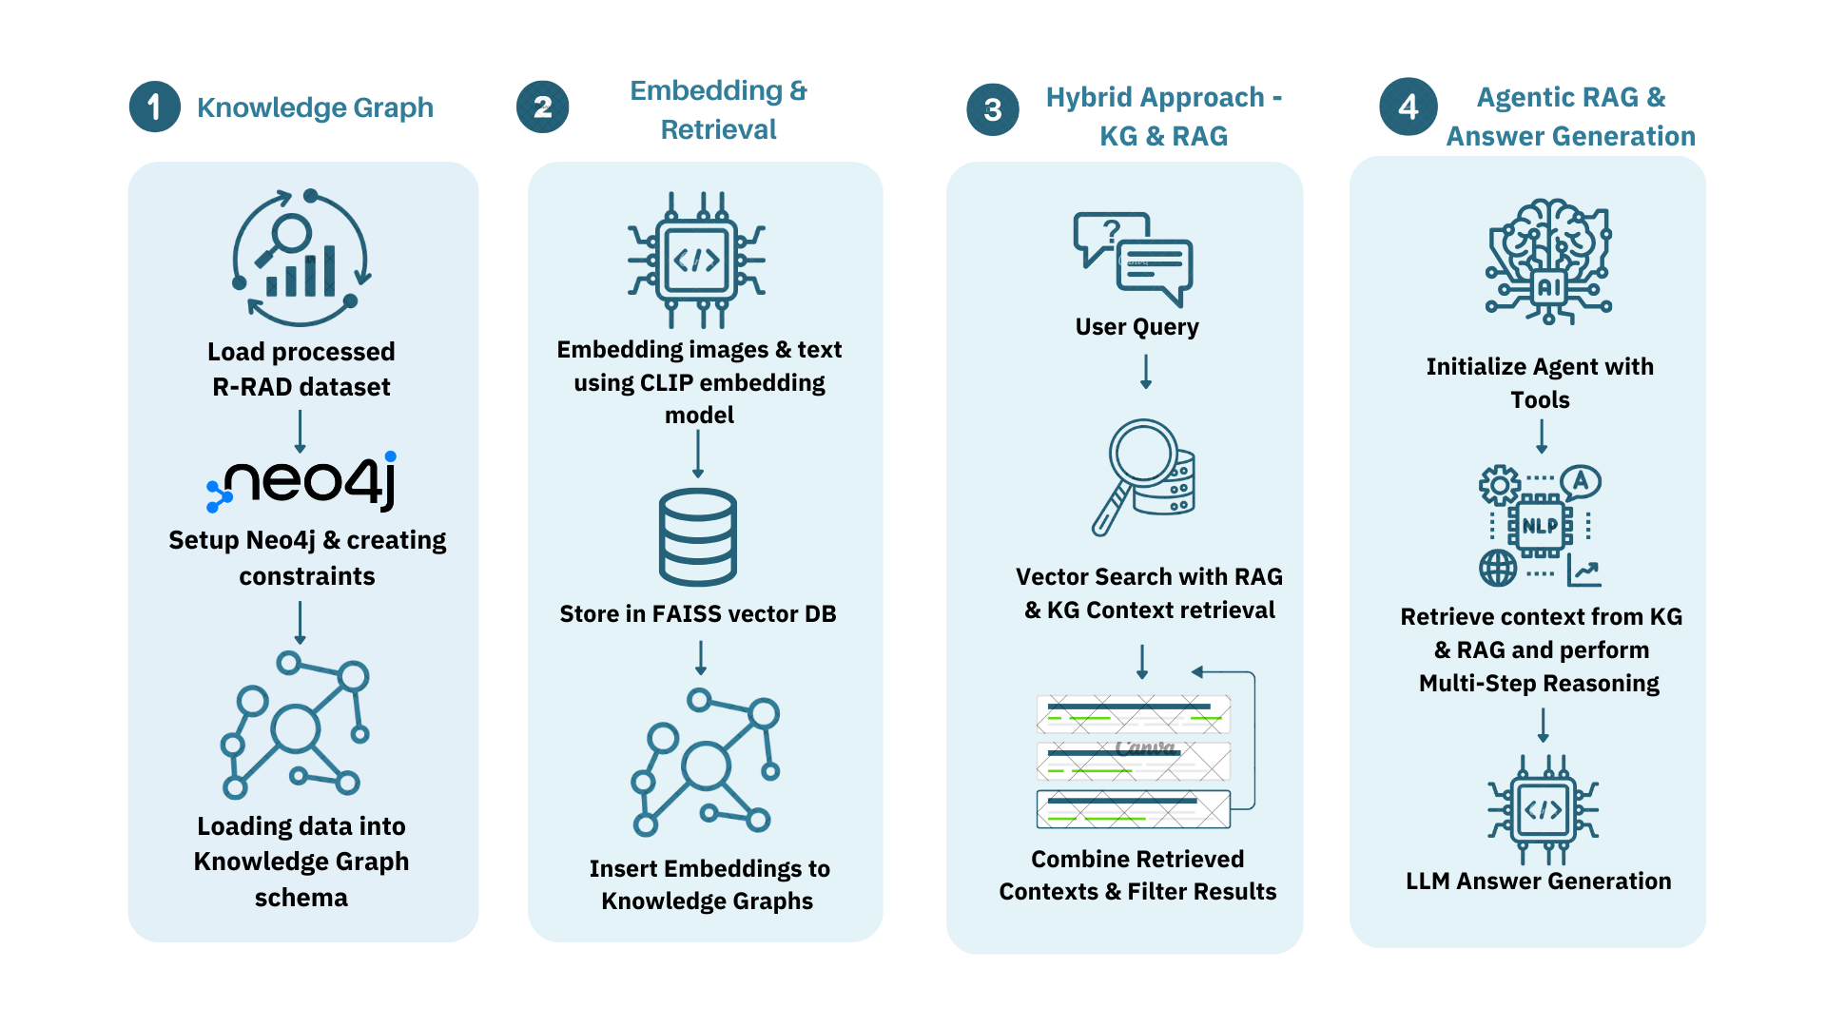
Proposed Pipeline

Slide 11
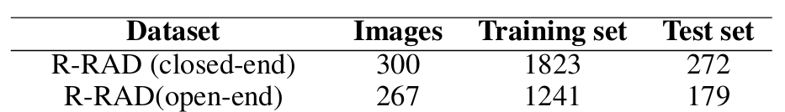
Dataset Description
A total of 3,064 training samples and 451 testing samples.
R-RAD Dataset consists of a question, answer choices, correct answer, medical image (primarily chest X-rays, MRI, or CT scans), organ depicted (e.g., chest, head, abdomen), and a detailed solution rationale.

Slide 12
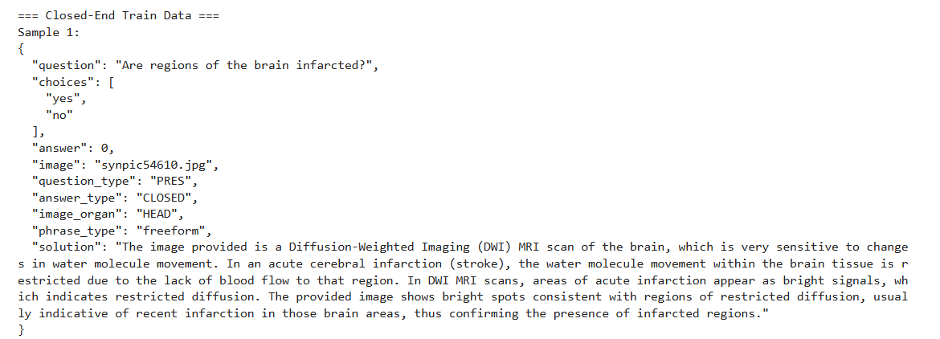
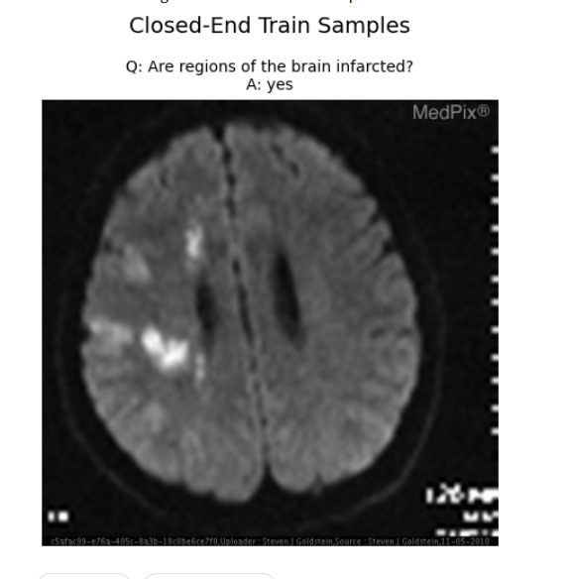

Slide 13
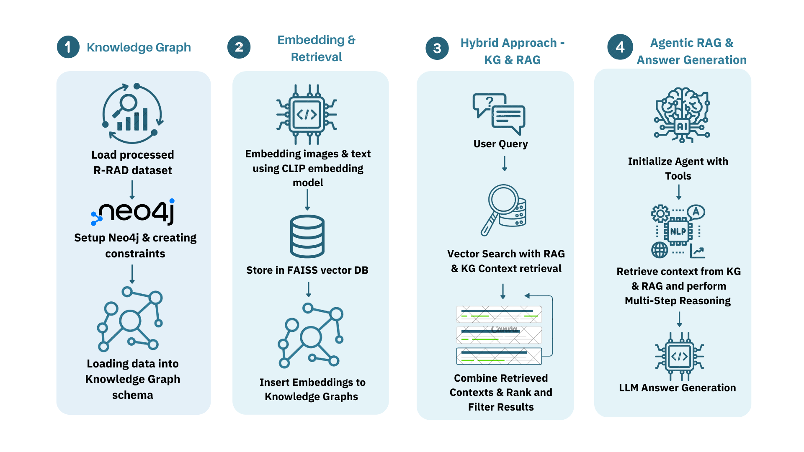
Knowledge Graphs
1) Prepare the dataset
2) Define constraints - Ensures unique constraints for nodes
3) Start loading data into batches (100) using the defined cyber query to create nodes and relationships.

Slide 14
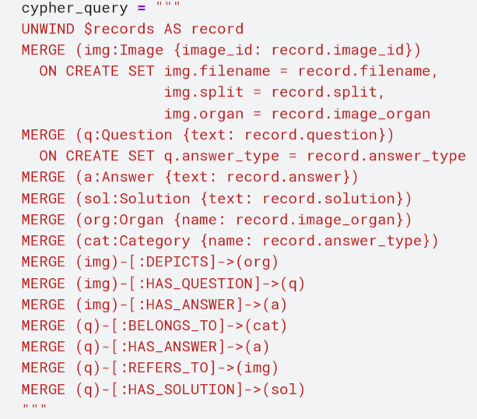

Slide 15
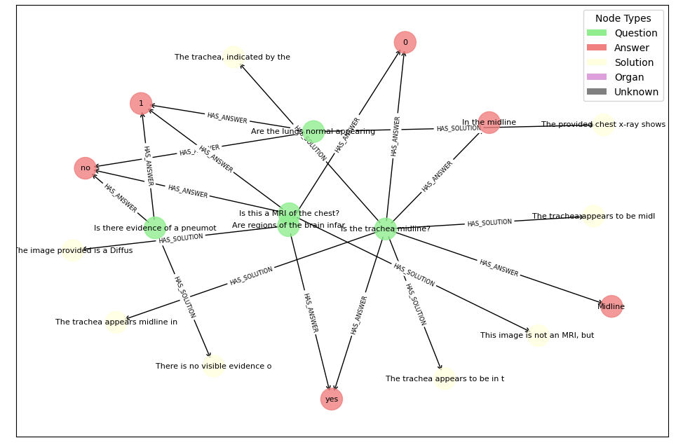

Slide 16
Embeddings & Retrieval
1) Embedded images and text using the CLIP embedding model
2) Embeddings are stored in the vector DB FAISS for retrieval
3) Insert the embeddings into the KG - Enables faster retrieval and similarity-based queries (find similar images or questions)

Slide 17
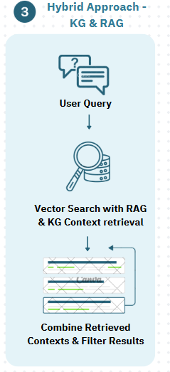
Hybrid Approach - KG & RAG
1) Use CLIP to create embeddings for the query image and question.
2) Retrieve Similar Instances with RAG
3) Fetch Structured Context from KG
4) Combine RAG & KG Results

Slide 18
AgenticRAG _ Core Idea
LLM as the "Brain": Utilizes Google Gemini (gemini-1.5-flash-latest) via Langchain's ChatGoogleGenerativeAI.
Empowered by Tools: Agent dynamically interacts with a knowledge base using four predefined specialized tools.
Goal: Gather relevant information before formulating an answer to a medical VQA query.
Process: Involves reasoning, planning, and strategic tool selection.

Slide 19
AgenticRAG _ The Agent's Toolkit
Tool 1: Textual Case Similarity Search
Function: Finds similar medical cases (Q&A pairs) from training data based on text.
Mechanism: CLIP text embeddings + FAISS index of question embeddings.
Output: Summaries of relevant cases (ID, image info, Q, A, rationale).
Tool 2: Visual-Semantic Image Retrieval
Function: Identifies images visually similar to a textual description.
Mechanism: CLIP text embeddings (for description) vs. FAISS index of image embeddings.
Output: Ranked list of relevant images with metadata.

Slide 20
AgenticRAG _ The Agent's Toolkit
Tool 3: Knowledge Graph Interrogation
Function: Retrieves structured, detailed info for a specific case from Neo4j KG.
Mechanism: Cypher queries based on Image ID or exact Question text.
Output: Detailed case profile (anatomy, question type, etc.).
Tool 4: General Graph Query Interface
Function: Allows unrestricted, custom Cypher queries for complex graph traversals.
Mechanism: Direct execution of sanitized Cypher strings against Neo4j.
Output: Query results.

Slide 21
AgenticRAG _ Agent Execution Framework (ReAct)
ReAct = Reasoning and Acting
Prompting:
Standard ReAct prompt (hwchase17/react) from Langchain Hub.
Customized Further: Specific instructions for the VQA task, schema awareness, radiological conventions, and required output format
Agent Creation: create_react_agent (Langchain) integrates:
Gemini LLM (Foundation Model)
The 4 Tools (Tool Suite)
ReAct Prompt Template

Slide 22
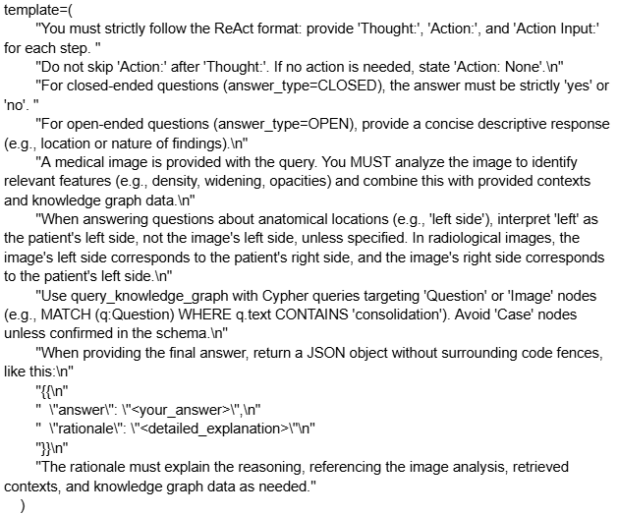
AgenticRAG _ Agent Execution Framework (ReAct)

Slide 23
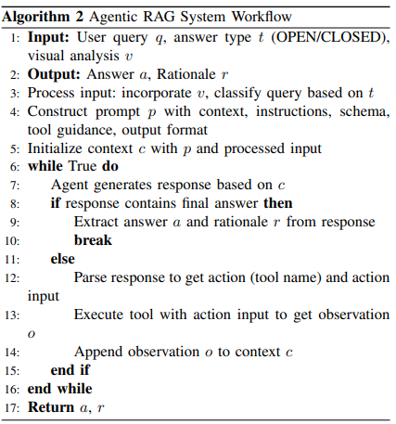
AgenticRAG _ The Agentic RAG Workflow

Slide 24
Answer Generation
1. Google Gemini (gemini-1.5-flash-latest):
A fast and efficient multimodal model from Google, excelling at reasoning, instruction following, and few-shot learning across text and images.
Role A: Initial Visual Analyzer for the Agentic RAG System and outputs a concise textual description of relevant visual findings, only providing a visual summary.
Role B: Reasoning Engine / "Brain" within the Agentic RAG System.
2. DeepSeek LLM (deepseek-r1):
A model recognized for strong instruction-following, coding, and logical reasoning, trained on diverse datasets for robust text understanding and generation.
Role: Text-Based Synthesis Engine in the RAG System Configuration, where it acts as an expert medical VQA assistant and outputs the Final Answer + Rationale.

Slide 25

Discussion and Results

Slide 26
Evaluation Metrics
Rouge
Bleu
Bert Score
Measures the overlap between generated and reference rationales in terms of n-grams and longest common subsequence.
Evaluates n-gram precision (up to 4-grams), focusing on fluency and content overlap
a semantic similarity metric that evaluates the closeness of the generated text to the reference text

Slide 27

Experimental Results
A. RAG & KG
B. Agentic RAG System Performance
KG + RAG pipeline using DeepSeek achieves the highest accuracy (85.57%) on closed-ended questions, outperforming the Med-
Think benchmark (83.5%) and Gemini-based systems. It also generates the best rationale explanations, with a BERTScore F1 of 87.82%.
The Agentic RAG Gemini underperforms across both question types. For closed-ended tasks, it records the lowest accuracy (62.59%) and rationale BERTScore F1 (58.72%).
On open-ended questions, Agentic RAG (Gemini) achieves ROUGE-1 recall of 23.78% and BLEU-4 of 2.42%, both significantly lower than other systems
On open-ended questions, KG + RAG
(DeepSeek) attains the highest ROUGE-1 recall (57.59%) and ROUGE-L recall (33.38%), indicating effective coverage and structure in generated rationales.

Slide 28
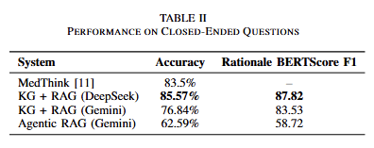
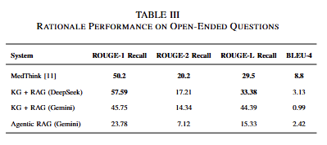

Slide 29

Key Findings
Closed-Ended Questions:
Open-Ended Questions
KG + RAG with DeepSeek delivers strong rationale quality (BERTScore F1: 84.81) but shows lower fluency (BLEU-4: 3.13, ROUGE-2: 17.21).
Agentic RAG with Gemini underperforms (BERTScore F1: 58.72, BLEU-4: 2.42)
KG + RAG with Gemini performs moderately with lower BLEU-4 (0.99).
Comparative Insights
The KG + RAG with DeepSeek achieves the highest accuracy (85.57%), outperforming the MedThink benchmark (83.5%).
KG + RAG with Gemini performs moderately (76.84%).
Agentic RAG with Gemini scores lowest (62.59%).
DeepSeek-based KG + RAG consistently outperforms others, proving effective for both question types.
The Agentic RAG system, while innovative and transparent, currently introduces inefficiencies and requires further refinement.

Slide 30
Limitations
1) Small Dataset Size:
With only 3,064 training and 451 test samples, the R-RAD dataset is limited in scale, increasing the risk of overfitting and reducing generalizability to diverse medical scenarios.
2) Domain Specificity:
The dataset focuses solely on radiology (e.g., X-rays, MRIs, CTs), restricting the system’s applicability to other medical imaging types like ultrasound or histopathology.
3) Computational Complexity:
The pipeline—combining knowledge graphs, embeddings, hybrid retrieval, and agentic RAG—is resource-intensive, posing challenges for real-time use in clinical settings with limited computing capacity.

Slide 31
Future Work
1) Expanding the dataset
2) Focus on enhancing the agentic infrastruc-ture, coupled with better generalization benchmarks and real-world clinical decision support in VQA.

Slide 32
Conclusion
This research proposes a robust approach to Medical Visual Question Answering (VQA) by combining knowledge graphs, semantic embeddings, hybrid retrieval, and an agentic RAG framework using the R-RAD dataset. The KG + RAG system, powered by DeepSeek, surpasses the MedThink benchmark with 85.57% accuracy on closed-ended questions and strong rationale generation (BERTScore F1: 84.81). However, the agentic RAG shows lower performance on open-ended questions (62.59% accuracy, low BLEU scores), revealing limitations in generalizability, tool dependence, and computational efficiency. Future work should expand the dataset, improve the agentic system, and reduce resource demands, laying a strong foundation for transparent and reliable clinical VQA applications.

